Slide 1




PsiHarmony
A website for holistic well-being

Slide 2


Problem Statement
Personalized Health Guidance
Empathetic Mental Health Chatbot Companion
Comprehensive Wellness Information at Your Fingertips
User-Centric Interfaces for Enhanced Health Understanding
Early Disease Detection and Accurate Diagnosis

Slide 3


Our Idea
We introduce to you, Mimir, the personal chatbot.
Mental Health Page: Gives the user interactive sessions with chatbots, and has elements of games, journal writing and ‘near me’
Physical Health Page: Shows your heart rate, steps, SpO2 data, calories burnt and sleep data.
Implementation of gamification elements and point system.

Slide 4

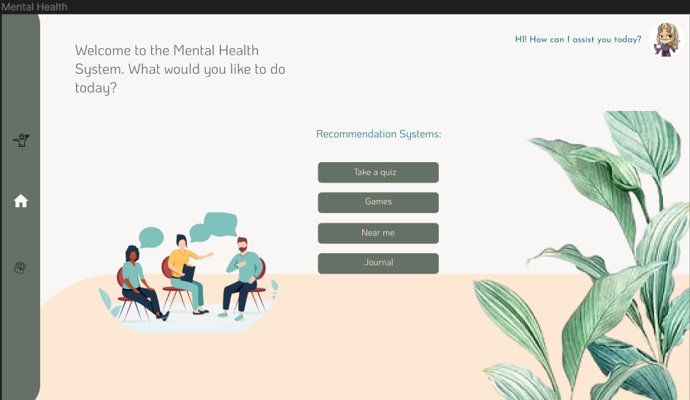
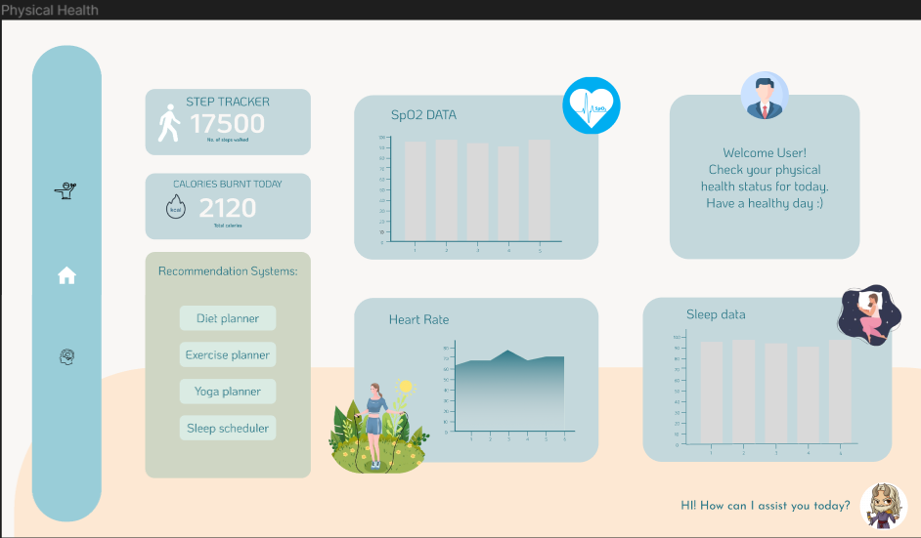

Future Webpage Design:

Slide 5
Current status of the project

Slide 6
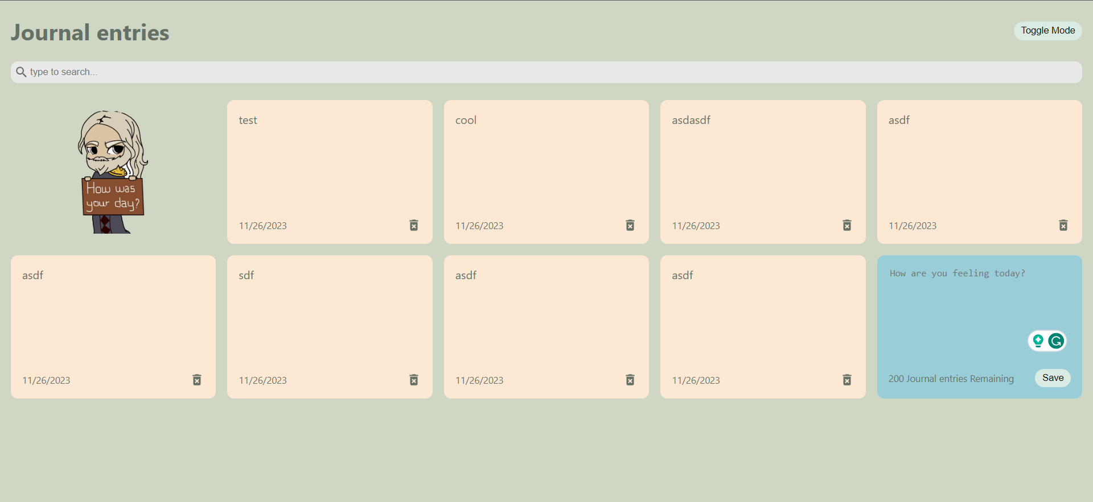



Slide 7
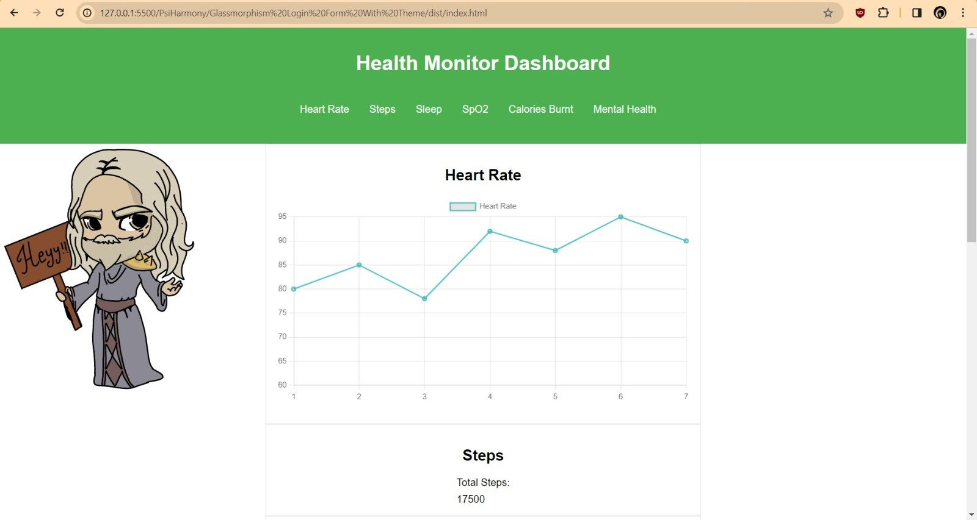

Slide 8
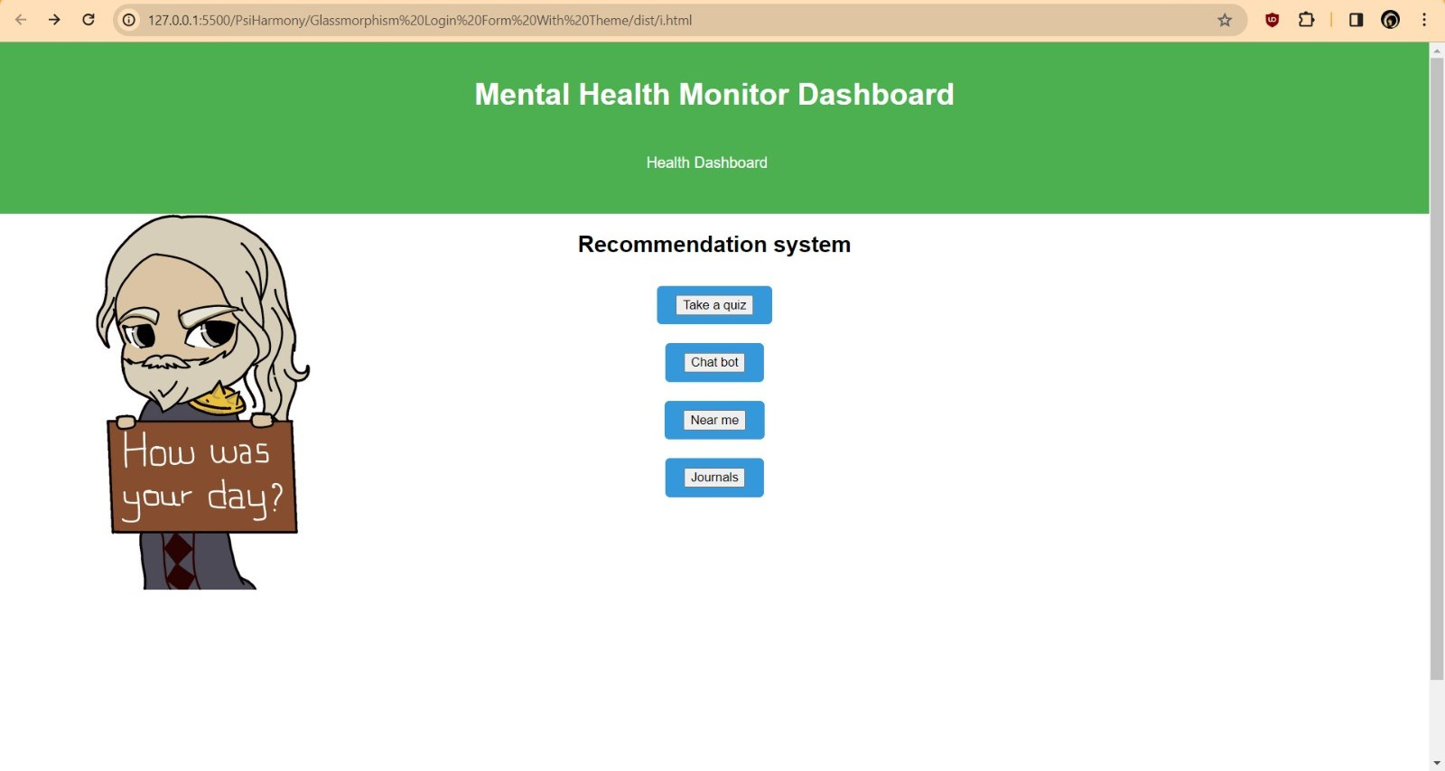

Slide 9
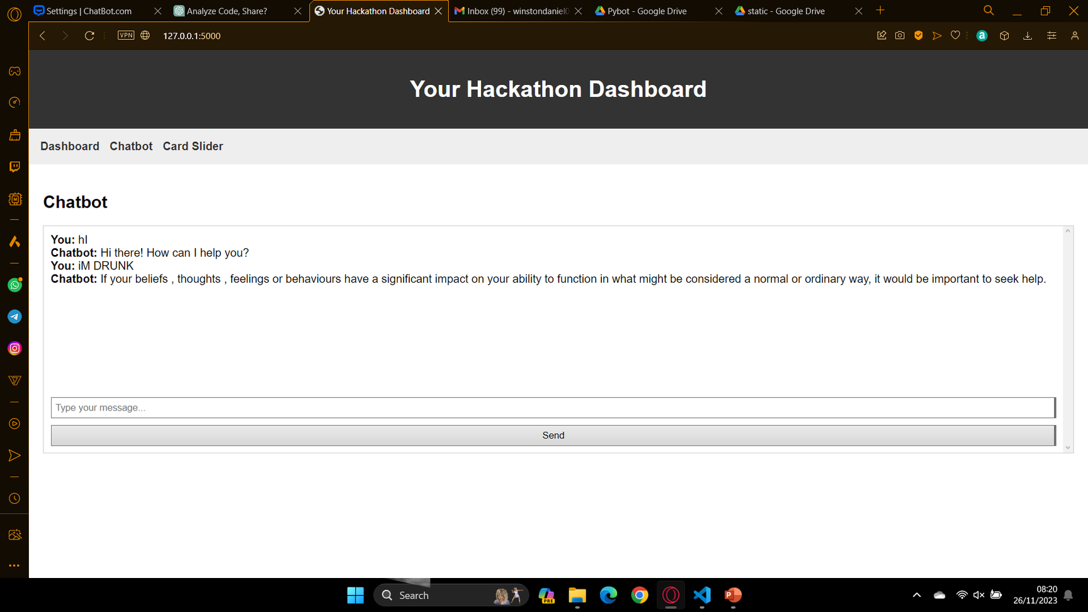

Slide 10
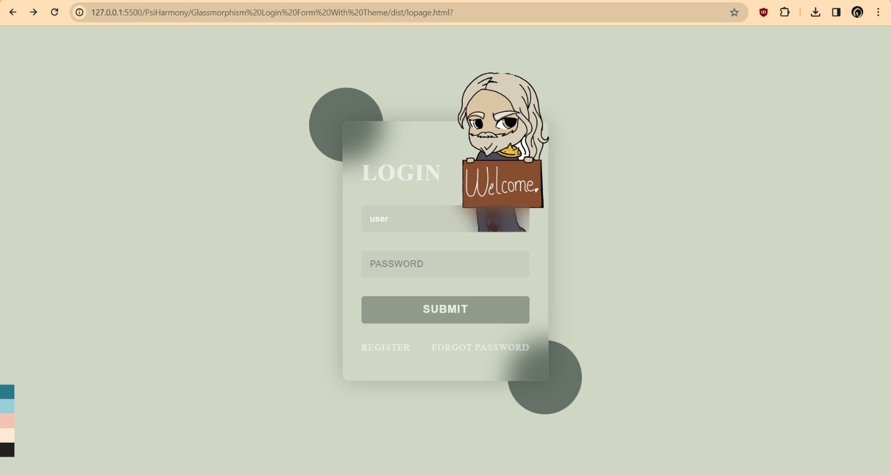

Slide 11


Future Approach Ideas:
User-Centric Design
Personalization
Interconnected Health Data
Community Engagement
Wellness Challenges
Mindfulness and Relaxation Hub
Goal Setting and Tracking

Slide 12
Team name: KinderHeim
Problem Statement number SNH02
Team leader name: Hriday Bekal
Institute name: N.M.A.M Institute of Technology
THANK YOU
We're ready to answer your questions.

